Slide 1
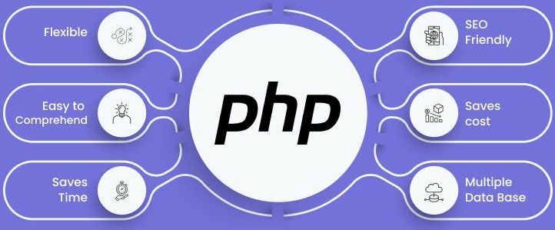

Slide 2
About today…
Security
Authentication
Authorization

Slide 3
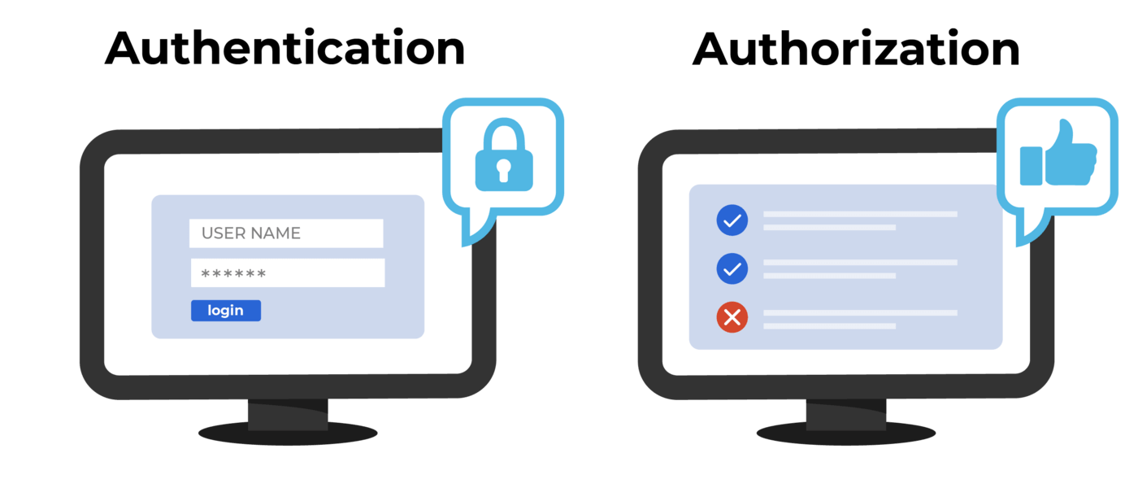

Slide 4
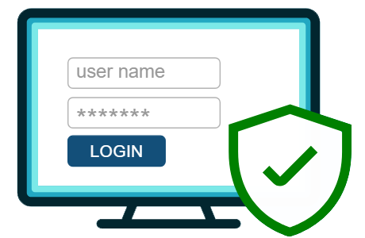
What is Authentication?
Definition
Authentication is the process of verifying the identity of a user. It ensures that the person accessing the system is who they claim to be
Methods
Common methods include username/password, biometrics (fingerprints, facial recognition), and two-factor authentication (2FA)
Importance
Authentication is the first line of defense against
unauthorized access and is critical for protecting
sensitive information

Slide 5

What is Authorization?
Definition
Authorization determines what an authenticated user is allowed to do. It controls access to resources based on user roles and permissions
Difference
Unlike authentication, which verifies identity, authorization checks if the user has the right to access specific resources or perform certain actions
Examples
Role-based access control (RBAC), permissions, and
access control lists (ACLs)

Slide 6
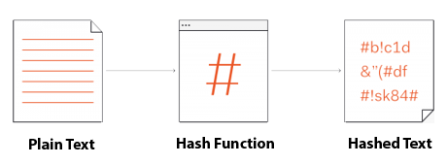
Password Hashing
Definition
Password hashing is the process of transforming a plain-text password into a fixed-size string of characters, which is typically a digest that appears random
Importance
Hashing passwords protects them in case of a database breach. Even if the database is compromised, hashed passwords cannot be easily reversed
Algorithms
Common hashing algorithms include MD5, SHA-1, SHA-256, and bcrypt (recommended)

Slide 7
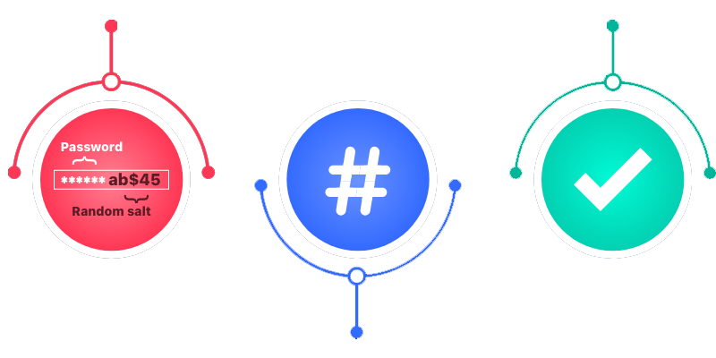

Using password_hash in PHP
Introduction
password_hash() is a built-in PHP function that creates a secure hash of a password
Syntax
password_hash($password, PASSWORD_DEFAULT)
Example
Explanation
PASSWORD_DEFAULT uses the bcrypt algorithm by default, which is strong and adaptive

Slide 8
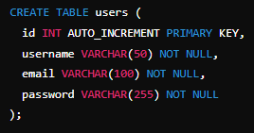
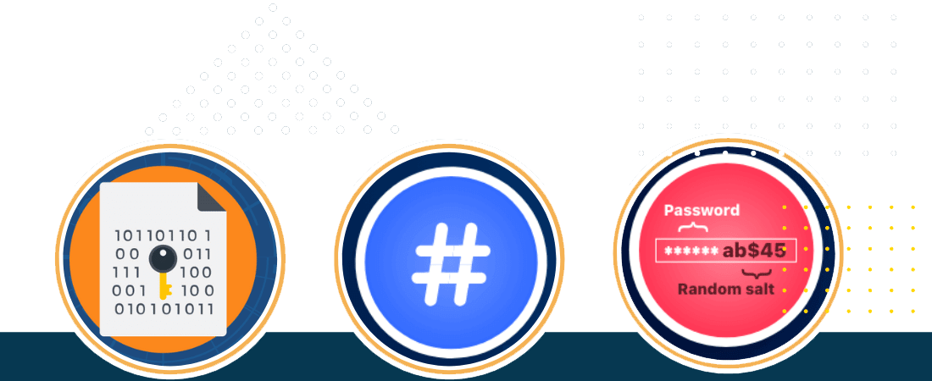
Storing Hashed Passwords
Best Practices
Store only the hashed password in the database, not the plain-text password
Database Schema Example
SQL Example

Slide 9
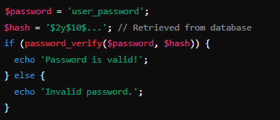

Verifying Passwords
Introduction
Use password_verify() to check if a given password matches the hashed
password stored in the database
Syntax
password_verify($password, $hash)
Example
Explanation
password_verify compares the plain-text password with the hashed password and returns true if they match

Slide 10
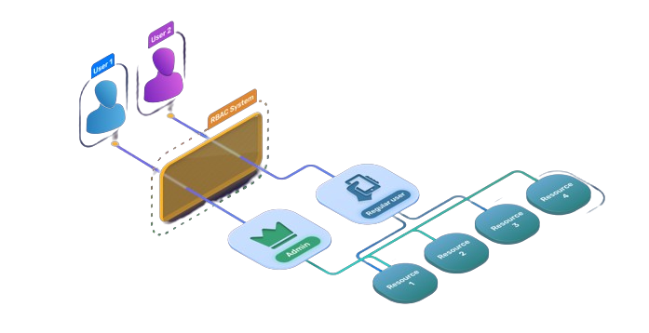
Role-Based Access Control (RBAC)
Definition
RBAC is a method of restricting access based on
user roles. It assigns permissions to roles rather
than individual users
Roles and Permissions
Define different roles (e.g., admin, user, guest) and assign
specific permissions to each role
Examples
Admins can create, read, update, and delete any content
Regular users can read and create content but cannot delete it

Slide 11


Slide 12

What is the primary purpose of authentication in web applications?
Which function in PHP is used to start a session?
What is the difference between authentication and authorization?
Which function in PHP is used to hash a password securely?
What is the purpose of password hashing?
What does RBAC stand for in web security?
In RBAC, what is typically assigned to users to define their permissions?

Slide 13

Task 1
Set up a simple RBAC system in PHP to restrict access to certain parts of a web application based on user roles

